Slide 1
Chocolate pieces

Slide 2
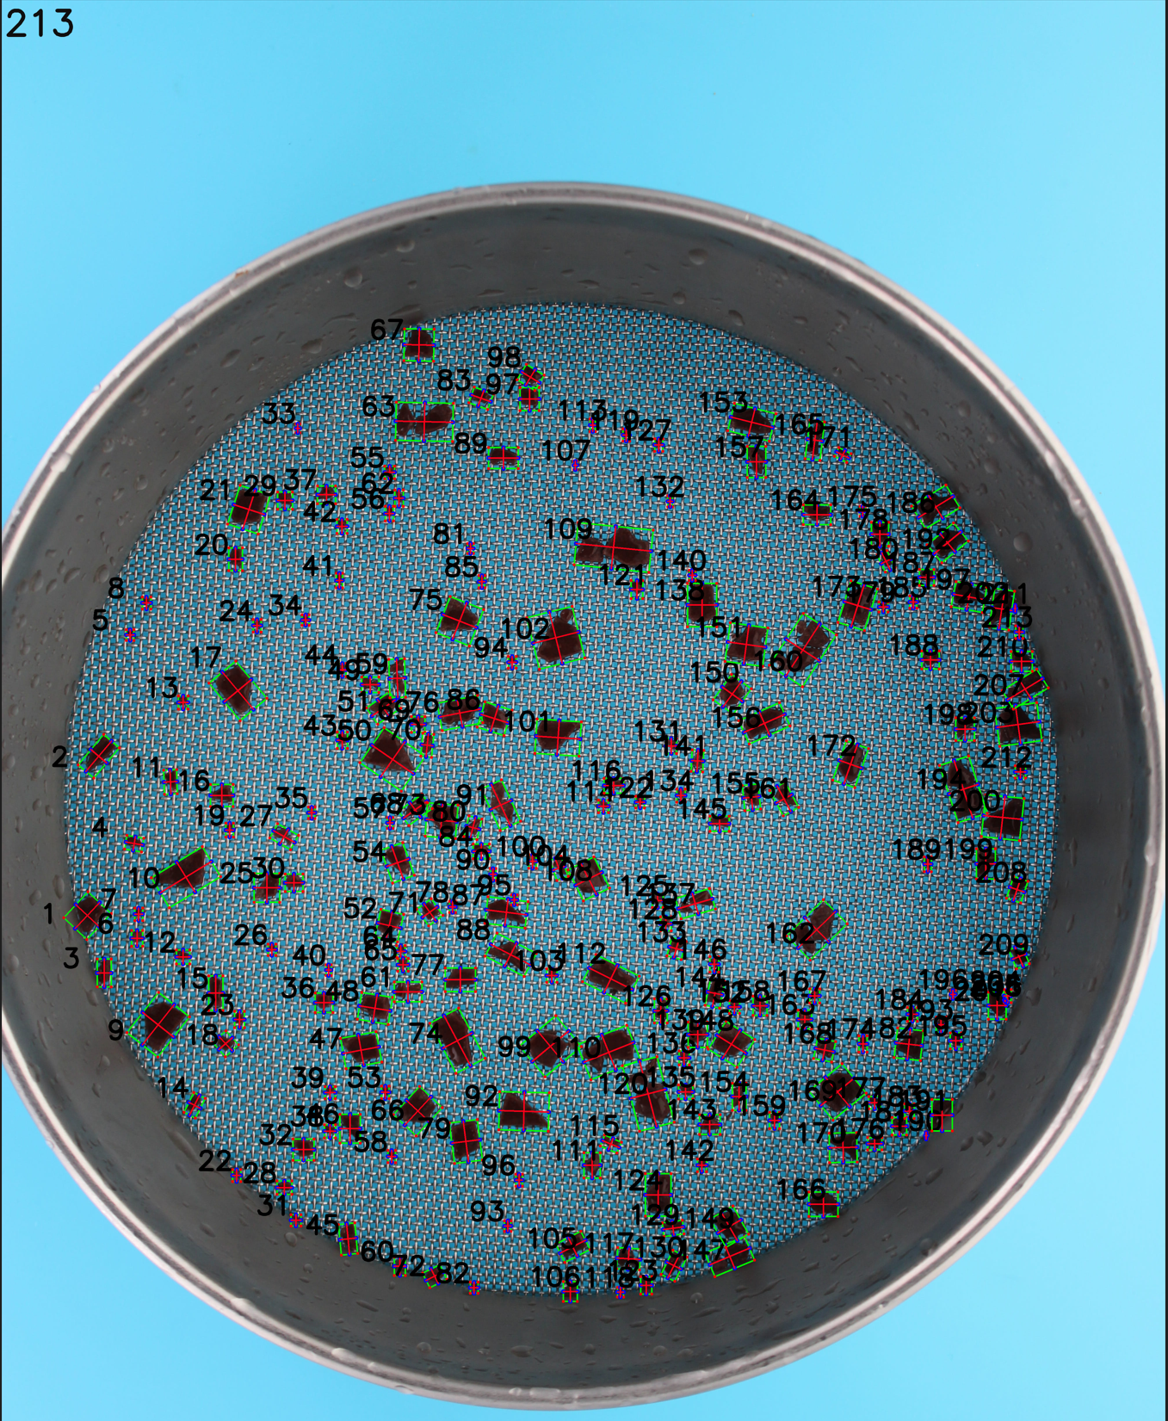
Approach 1- Minimum enclosing rectangle (1/3)
Prompt user to enter height or width with an actual uom for one of the labelled pieces in an image

Slide 3
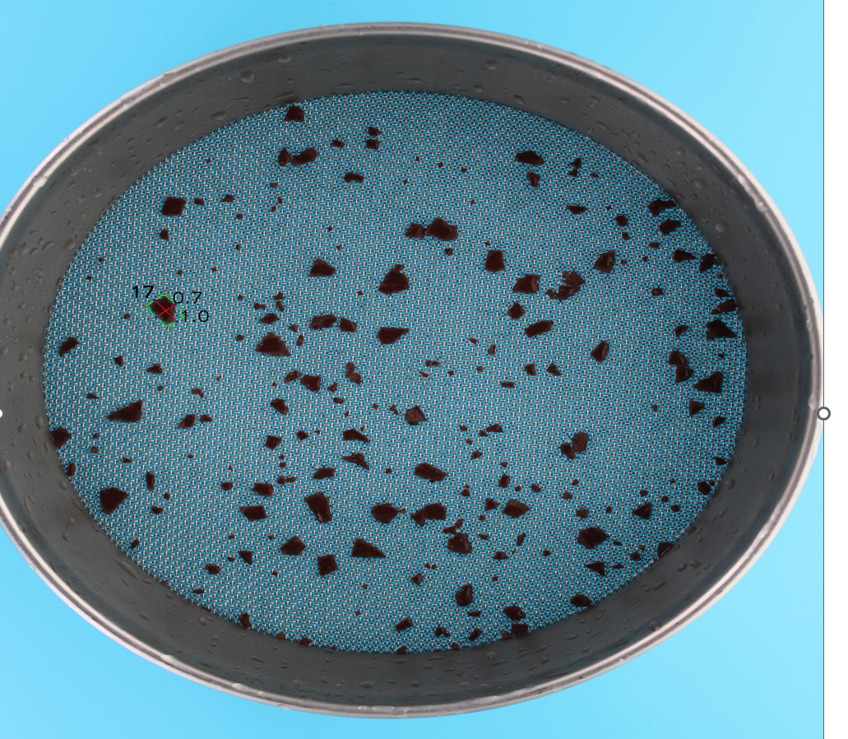
Minimum Enclosing rectangle (2/3)
Using this, we can calculate the actual height and width of the minimum enclosing rectangle for the polygon.
Notes:
How actual size of a piece is counted –
For the chosen piece from the image, a minimum enclosing rectangle is drawn around the polygon
Then, the following midpoints for the enclosing rectangle are calculated -
Top left – top right
Bottom left – bottom right
Top left – bottom left
Top right – bottom right
Using these 4 midpoints - highlighted by blue circle and joined by red lines – we compute the Euclidian distance between for the line joining the midpoints. More on Euclidian distance here - https://www.cuemath.com/euclidean-distance-formula/
The result of this calculation gets us two values – height and width in pixels.
To get the conversion of height and width into equivalent uom measures, we define and use pixel per metric which is the ratio between width in pixels/actual width.
In this specific example, I have taken the width as 1 inch. Using this 1 inch value, height was calculated to be 0.72 inches.
To elaborate this further, for piece 17, we have assumed the width of this piece to be 1 inch. Our pixel per metric becomes 167.22/1 = 167.22 –
Height in pixels : 119.65
Width in pixels : 167.22
Width in inches : 1 (This is the input we need, it’s assumed)
Height in inches : 0.72 ( [119.65*1] * 167.22 )
Using our pixel per metric value, we similarly compute height and width for other pieces
We can then calculate area and use it filter the pieces relevant to us on the base of sizes.

Slide 4
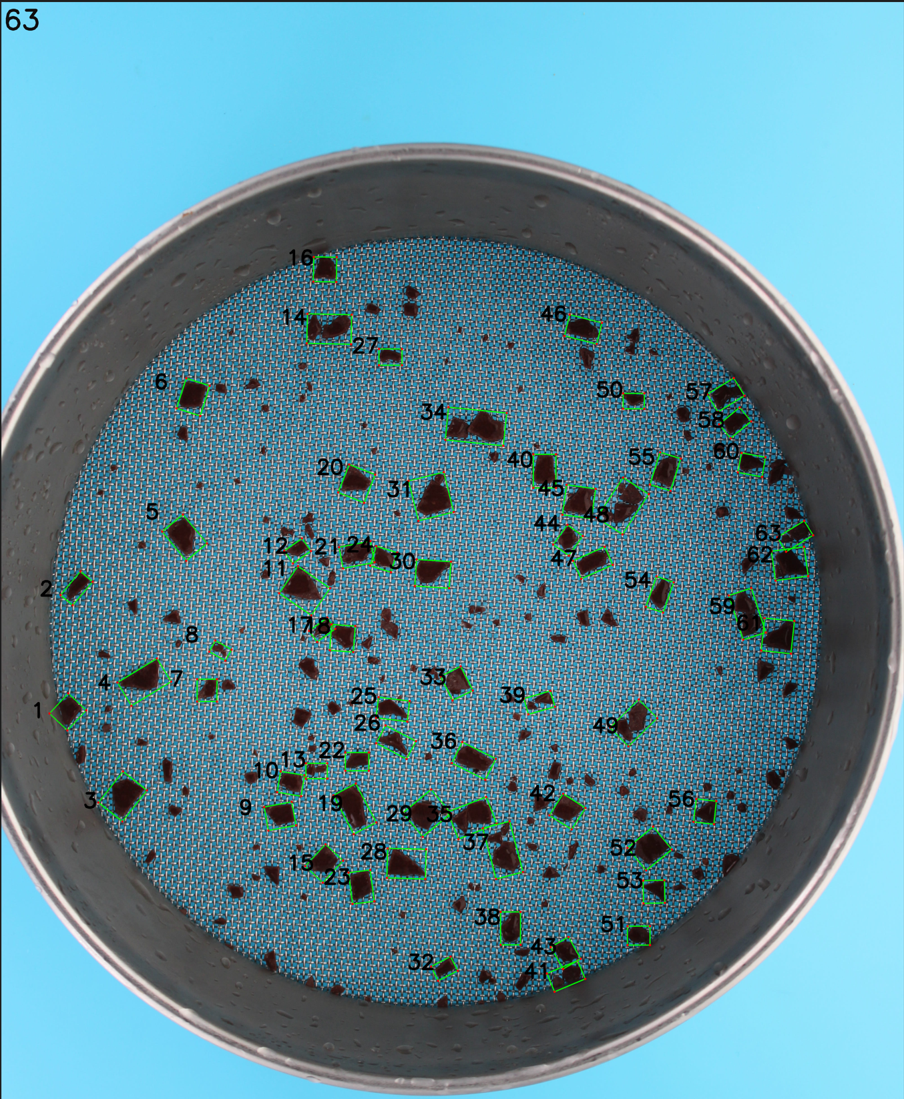
Minimum Enclosing rectangle (3/3)
We can now filter using the calculated dimension. The following result is for less than 80 pixels or 0.48 inces (width) –

Slide 5

Approach 2 - Rectangle
We draw a rectangle around counted pieces and have access to height and width in pixels, which can be further used for filtering. Note : This approach doesn’t account for rotation of images. Here it’s filtered on area (h*w) > 8000 :

Slide 6

Approach 3 – Enclosing Circle
Drawing a circle around identified pieces. Can calculate area using radius and use that to filter for relevant pieces.

Slide 7

Approach 4 – Default shape
Open CV has access to actual area of the contour itself. It returns area in pixels and can be used for filtering for relevant pieces.

Slide 8
Observations
Overall, visually overlapping pieces are difficult for the algorithm to differentiate. If pieces overlap, it’s likely to count it as a whole unit. Many permutations were tried here to detect sharp edges, but if the edge detection is kept very sharp – it ends up counting a lot of smaller pieces (noise). Capturing sharpness = unreasonably high counts.
For the fourth approach, even if we use the area of the actual piece that we have access to, it seems to miss pieces that are visually big (this most likely happens because of the way it counts pieces)
For rectangle approach, it doesn’t account for rotation and draws the rectangle. This results in somewhat bigger measurement of pieces than it actually is. Similar observation for the circle approach.
Using the minimum enclosing rectangle approach seems most reasonable to validate. It does take additional pixels around the actual piece to draw the rectangle, but it accounts for rotation and the returned results translate into meaningful and real pixel <---> uom conversion.

